Slide 1
NBA STATS GROUP 1
Authors: Loc Bryan Truong Anthony Cardoza, Jose Eichenseer, Tro Haboian, John McCarty, Vinh Nguyen
Instructor: Jongwook Woo

Slide 2

Introduction
NBA Forecast
Top 25 players ranked
NBA Stats 2017-2021
Points, Rebounds, Assists, 3-Point %
Software: SAP Cloud Analytics
Compare results to 2022 Season
Disclaimer - Outliers from other categories: injuries, sickness, rest time for games, etc.
Notes:
Forecast top 25 NBA players for current season
Data Used: NBA Statistics from 2017-2021
Categories: Points, Rebounds, Assists, Three-point Percentage
Top 25 ranked players in the NBA
Software: SAP Cloud Analytics
Visualization
Forecasting
Compare results to 2022 Season
Accuracy
Disclaimer - Outliers from other categories: injuries, sickness, rest time for games, etc.

Slide 3
Related Work
Stat Prediction Saturation
Depth of Data
Information Accuracy vegasodds.com - Profit
Comparison Data Sites
Notes:
The market for NBA stat predictions is heavily saturated, with the main difference from each site being what data they are implementing.
Some sites use basic stats 3 point percentage, Points Per Game, rebounds and turnovers. Other sites go more in depth adding if a player is sick, if they have gotten injuries, do they like playing with their teammates.
The most accurate information at hand currently comes from vegasodds.com, the reason for this is because there is a profit to be made, when there is profit to be made the risk of getting data sets incorrectly is amplified.
Other sites we used to compare our datasets to were NBA.com, Sportsline.com, and Fantasydata.com

Slide 4
General Instructions
Stats from NBA.com
Last five year top 25 ranked players
Top 25 players within a 5 year period
Top 25 ranked players consistently within the last 5 year
Most updated information
Most accurate information
Updated hourly
Notes:
VN
NBA.com
Owned by warners’ media
We had imported our stats from NBA.com making them the most accurate information we can have.
The data sets are updated by the National Basketball Association hourly, making the website the number one place to import our data from.
We began to export the last five year top 25 ranked players, then we exported the top 25 players within a five year period, and the top 25 ranked players consistently within the last five year.
This allowed us to use the data sets to create our story with the most updated information available.
Last 5 years top 25, is top 25 players each year over 5 yr
Top 25 over 5 years are all players who were in the top 25 during those time
The data was gathered from NBA.com, which is controlled by the National Basketball Association, making this data source the most accurate information available. The data is updated consistently even with live updates on players and team stats. These stats go all the way back to when the NBA began. We will use the data of the top 25 ranked players over the last 5 years of play. There were 9 concurrent players within the last 5 years, making them our final dataset. The total size of the data will be a little over 70KB of data in Excel format.

Slide 5
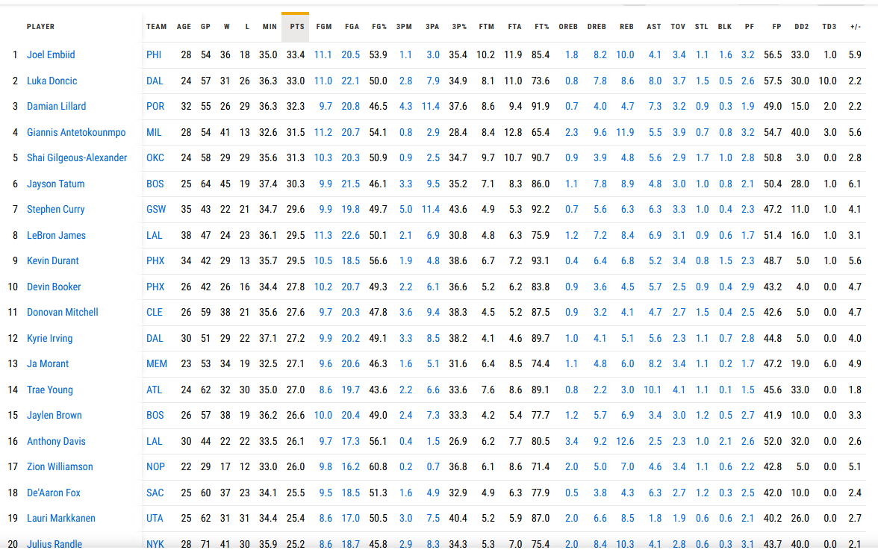
Implementing Data
NBA.com Data
Player Stats
Customizable
Notes:
The National Basketball Association has been keeping record for over a decade. Data is easily accessible on NBA.com The NBA’s data bank keeps all kinds of different types of statistics. For this Project we decided to focus on importing all the player stats
So we imported all the stats of the players that in the past 5 years consistently were among the the top 25 players in the NBA (name a few players) We chose to implement all of the statistics available of these 25 players because it allows is to further customize our SAP Model and Story

Slide 6
Processing Data
ACTIVITIES
FEEDBACK
When we were setting up our data to be processed by SAP we had clarity as a top priority, having the data at hand is one part, being able to read and fully understand the data as a user is the other part.
When uploading data we wanted each table to demonstrate a year of regular season, instead of showing all seasons of players in one table.
GOALS
EVALUATION
Once we had imported and created each table for regular seasons it was time to create a forecast graph.
The forecast graph consists of players that were ranked top 25 for the past five years consistently; total 9 players.

Slide 7

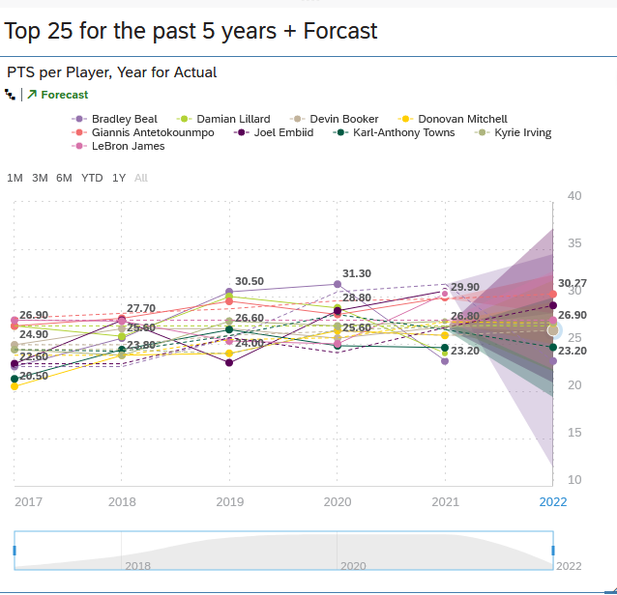
Processing Data - Graph

Slide 8
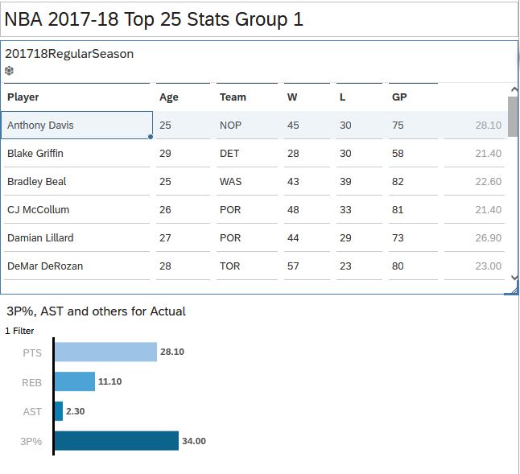
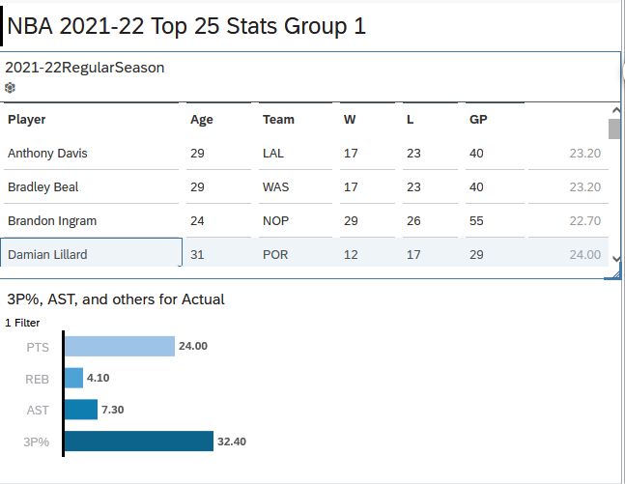
Points, Rebounds, Assists, 3 point %
Dynamic Tables
5 Dynamic tables
Clarity and legible
When selecting a year and player stats update automatically.
Example: Anthony Davis 2017-18 on the left, Damian Lillard 2021 - 22 on the right.

Slide 9
Top 25 Ranked Players Consistently Forecast
Player | Upper Confidence | Lower Confidence | Average | Current
Bradley Beal | 34.48 | 11.92 | 23.20 | 23.10
Damian Lillard | 32.70 | 22.10 | 26.90 | 32.23
Devin Booker | 28.05 | 24.82 | 26.44 | 27.00
Donovan Mitchell | 29.44 | 24.96 | 27.20 | 27.50
Giannis Antetokounmpo | 32.29 | 28.25 | 30.27 | 31.30
Joel Embiid | 37.22 | 20.89 | 29.05 | 33.00
Karl-Anthony Towns | 29.90 | 19.37 | 24.64 | 20.80
Kyrie Irving | 28.25 | 26.24 | 27.24 | 27.00
Lebron James | 32.70 | 22.30 | 27.50 | 29.50
Example: Bradley Beal, Damian Lillard

Slide 10

Conclusion
Once data imported /processed we can start to make predictions and comparisons to live stats
Confirm accuracy by comparing the forecast to the current season
Examples
Notes:
Once data imported and processed we can start to make predictions and comparisons to live stats.
When looking at the data we can see the accuracy of the data by comparing the forecast to the current season.
Example: With our data our forecast shows Bradley Beal averaging 23.20 points per game, his current stat for the current regular season is 23.10. Showing the accuracy of the model.
On the other hand we can see how leaving our key data points, such as injuries, sickness, and games missed will affect the outcome of our averages.
Example: our model shows an average for Joel Embiid at 29.05, but his current stats for points per game is 33.00.
Our forecast upper confidence bound is still within the limits of Embiid’s current stats.

